Slide 1

Big Mart Sales Prediction
Lachandra Ash
10/31/2022

Slide 2

Big Mart History
The Big Mart Brand's global expansion began in 2007 in the United States of America.
Located in both upscale and more casual shopping areas.
Big Mart has a wide selection of things that people use on a regular basis, such as food, beverages, snacks, desserts, ice cream, tobacco products, magazines, and newspapers.
Big Mart is now a globally recognized retail powerhouse with over 40 locations

Slide 3



Agenda
Construct a Linear Regression Model.
Predict item sales at Big Mart.
Reveal the impact of the target variable upon the other variables.

Slide 4

The Target Variable
Item Outlet Sales
The number of sales per item within the stores.
The item sales may take place online or in person.
The other features within the dataset has some type of influence on the item sales.

Slide 5
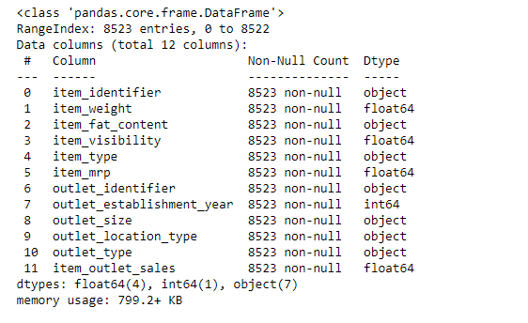
Big Mart Train Dataset

Slide 6
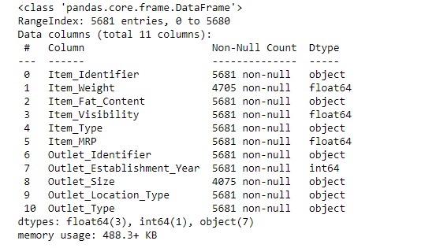
Big Mart Test Dataset

Slide 7
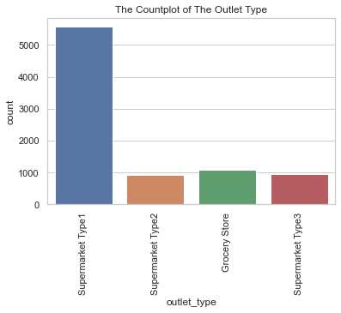
The Outlet Type Countplot
Subtitle
The supermarket type 1 has the highest number of outlets of its type.
The grocery store and supermarket type 2 outlets have almost the same number of outlets of its type.
The supermarket type 2 has the least number of outlets of its type.

Slide 8
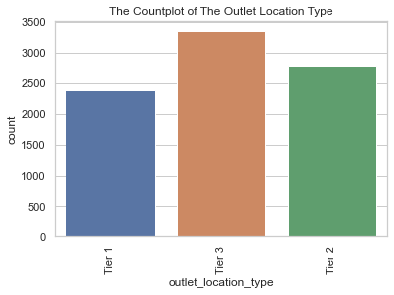
The Outlet Location Type Countplot
The tier 3 location has the highest number of outlet locations of its type.
The tier 2 location has the second highest number of outlet locations of its type.
The tier 1 location has the least number of outlet locations of its type.

Slide 9
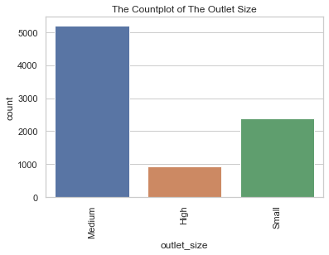
The Outlet Size Countplot
The medium sized outlet has the highest number of outlets of its size.
The high sized outlet has the least number of outlets of its size.
The small sized outlet has the second highest number of outlets of its size.

Slide 10
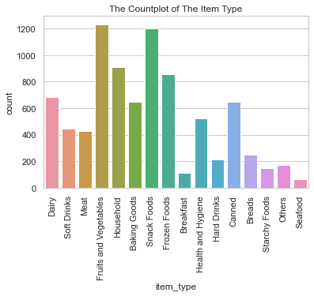
The Item Type Countplot
The fruits and vegetables and snack foods item types has the highest number of items within the store. They are less in demand.
Seafood, others, starchy foods, breads, hot drinks, and breakfast items have the lowest number of items int the store, and they are more in demand.
Dairy, soft drinks, meat, canned foods, health and hygiene , baking goods, and household items vary in range of demand.

Slide 11
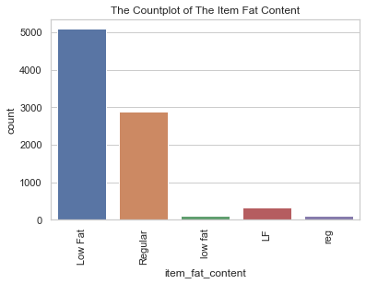
The Item Fat Content Countplot
The low-fat content food items has the highest number of food items with low fat.
The regular fat content food items has the least number of food items with regular fat content.

Slide 12
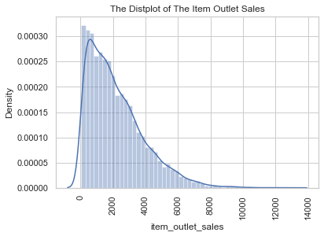
The Distribution of The Item Outlet Sales
The item_outlet_sales distribution plot displayed the distribution is right skewed.
The item_outlet_sales possess a normal type of distribution.

Slide 13
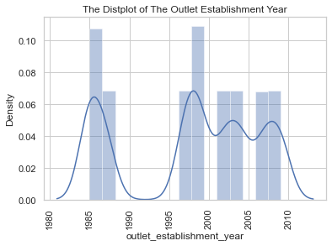
The Distribution of The Outlet Establishment Year
The outlet_establishment_year distribution plot displayed there were more outlets established in 1985.
The least number of outlets were established in 1998.
There were almost the same number of outlets established in 1987, 1997, 1999, 2022, 2004, 2007, and 2009.

Slide 14
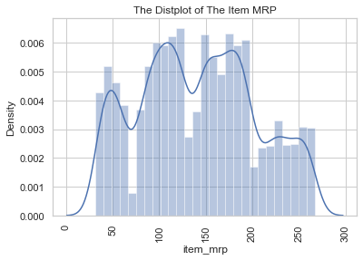
The Distribution of The Item MRP
The item_mrp distribution plot displayed the item_mrp has a symmetric distribution.

Slide 15
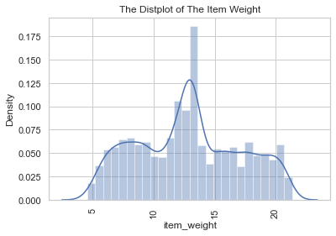
The Distribution of The Item Weight
The item weight distribution plot displayed the item weight distribution is symmetric.

Slide 16
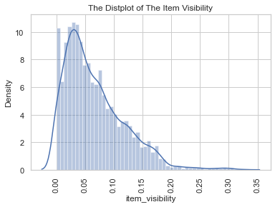
The Distribution of the Item Visibility
The item visibility distribution plot revealed the distribution curve revealed it is least susceptible to having outliers.
The distribution has a positive type of skew which means the items are less visible.

Slide 17
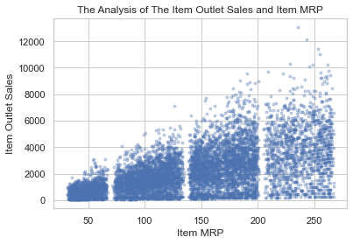
The Item Outlet Sales and Item MRP Scatterplot
When the item mrp rises, so does the item outlet sales.

Slide 18
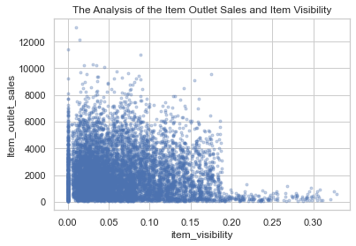
The Item Outlet and Item Visibility Scatterplot
The item visibility scatterplot displayed if the visibility of the item is less than the number 0.100, the items have higher sales.

Slide 19
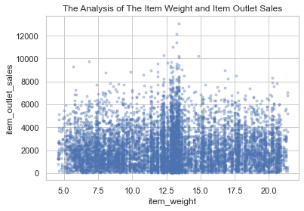
The Item Outlet Sales and Item Weight Scatterplot.
The item outlet sales and item weight scatterplot displayed there is no relationship between the two.

Slide 20
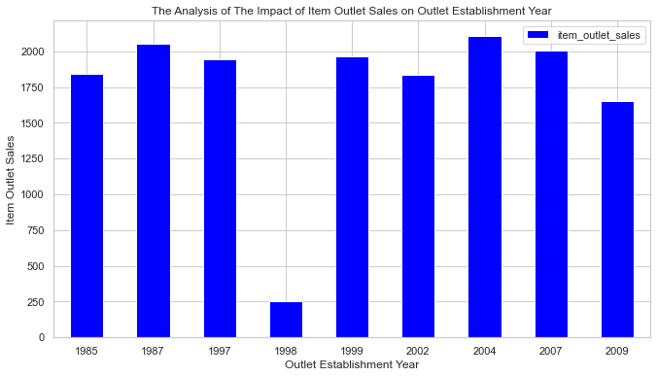
The Item Outlet Sales and Outlet Establishment Year Barplot
The outlets in 2004 and 1987 gained the highest number of item sales.
The outlets in 1998 gained the least number of item sales.
The outlets in 1985, 1997, 1999, 2002, and 2007 gained item sales between 1750 – 2000 sales.
The outlets in 2009 and 1998 did not gain any item outlet sales greater than 1750 sales.

Slide 21
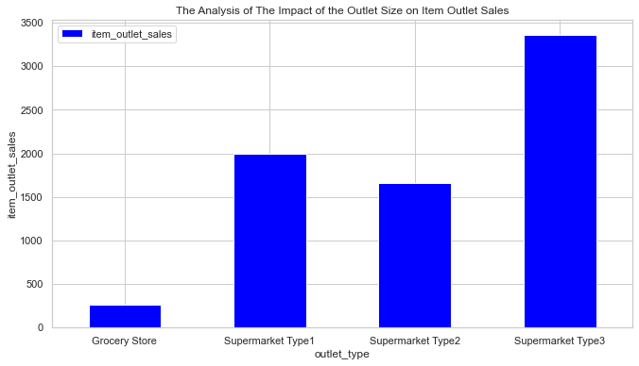
The Outlet Size on Item Outlet Sales
Supermarket type 3 has the highest number of item outlet sales.
Supermarket type 1 has the second highest number of item outlet sales.
Supermarket type 2 and Supermarket 1 are the only supermarkets that gained between 1,500 – 2,000 number of item sales.
The grocery store gained the least number of item sales.

Slide 22
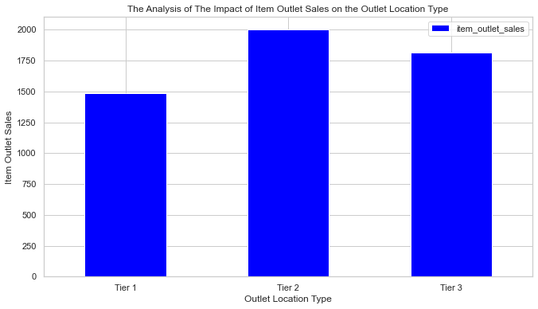
The Item Outlet Sales on Outlet Location Type
Tier 2 has the highest number of item outlet sells.
Tier 3 has the second highest number of item outlet sales.
Tier 1 has the least number of item outlet sales.
Tier 2 is the best location to own stores in because the owners will gain the most money in Tier 2 versus the other tiers.

Slide 23
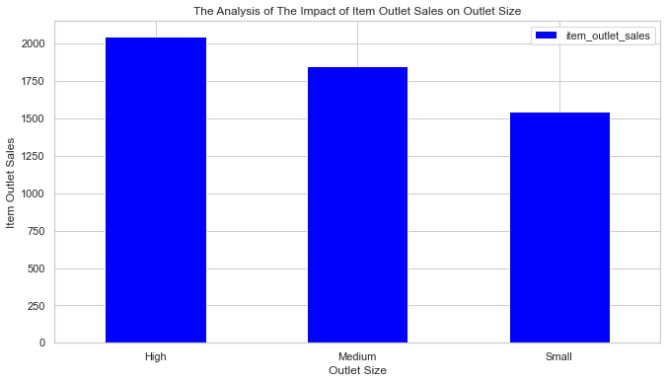
The Item Outlet Sales on Outlet Size
The high sized outlet gained the most item outlet sales.
The medium sized outlet gained the second highest number of item outlet sales.
The small sized outlet gained the least item outlet sales.

Slide 24
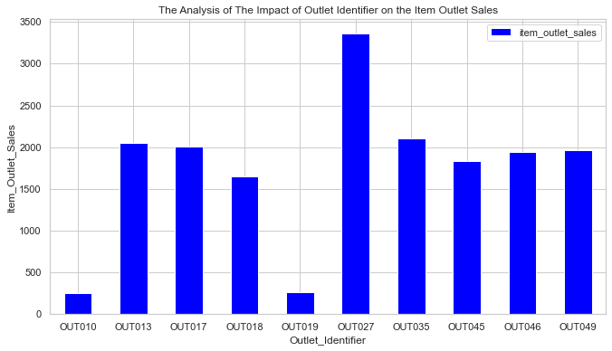
The Outlet Identifier on Item Outlet Sales
The Out027 gained the highest number of item sales.
The Out010 and Out019 gained the least number of item sales.
The Out013, Out017, Out035, Out046, and Out049 gained near the same number of item sales.
The Out018 and Out045 gained near the same number of item sales.

Slide 25
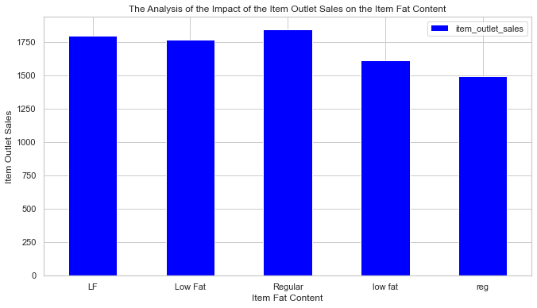
The Item Fat Content and Item Outlet Sales
The low-fat content item has the least number of item sales.
The regular fat content item has the highest number of item sales.

Slide 26
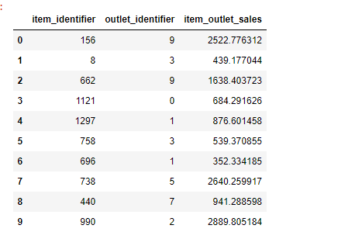
The Gradient Boosting Regressor Model
Made predictions on validated data
The validation seed was 7
The validation size was 0.20
RMSE = 237.7863656123978
Used StandardScaler to fit the model
The model predicted the item outlet sales for each item at every outlet.

Slide 27

Conclusion
The supermarket type 1 has the highest number of its outlet type, and tier 3 outlet location is the best city for outlet location type. The tier 3 location has the most outlets. Most of the outlet sizes are medium sized. The fruits and vegetables and snack foods items have the highest consumer demand. Big Mart should focus on increasing the demand for the breakfast, hard drinks, breads, starchy foods, other foods, and seafood items, to gain more item sales. There is a higher number of low-fat content versus regular fat content food items.
The higher the item’s mrp, the higher its sales will increase. The impact of item outlet sales on outlet establishment year is the outlet established in 2004 had the highest number of item outlet sales, but the least number of outlets were established in 1998. The supermarket type 3 gained the highest number of item sales, and the outlet located in tier 2 location gained the highest number of item sales, making it the best location to earn more profit from consumers.
The high sized outlets are the larger sized outlets that received the highest number of item sales. The food items with regular fat content are in higher demand than the foods with low fat content. The regular fat content foods earned the highest number of food item sales. The OUT027 outlet obtained the highest number of item sales, which makes it the most popular outlet with more items in demand.

Slide 28

Any Questions?

